Slide 1
Simple online and offline resources for making learning more interactive
Lex Nederbragt
http://pad.software-carpentry.org/swc-instructor-retreat-2015-3PM-UTC
Centre for Evolutionary and Ecological Synthesis
University of Oslo

Slide 2
Outline
Who am I
Let’s assemble a genome together!
Multiple choice quizzes
Q&A, discussion

Slide 3




Who am I
@lexnederbragt
flxlexblog.wordpress.com

Slide 4
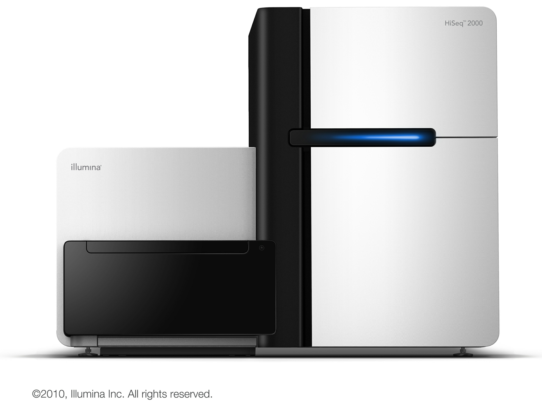
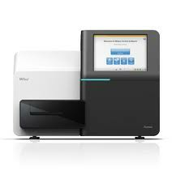
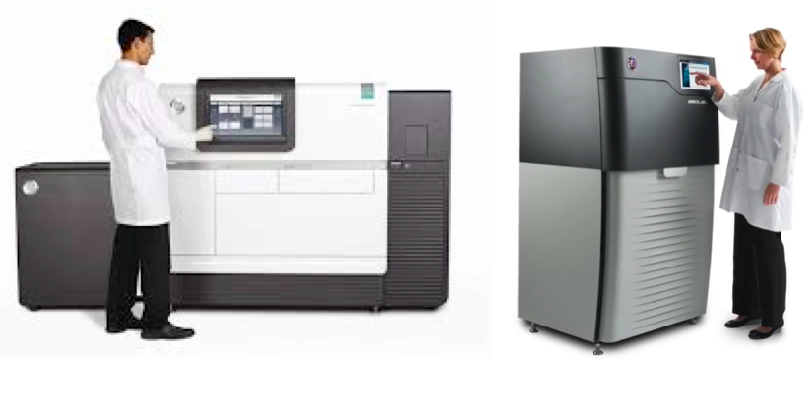
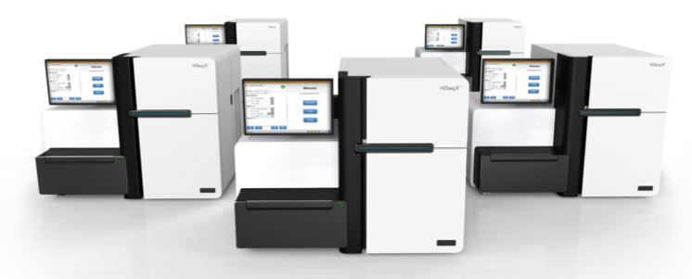
What do we do
HiSeq 2500 from Illumina
MiSeq from Illumina
PacBio RS II from
Pacific Biosciences
2016
Sequel from
Pacific Biosciences ?
HiSeq X five from Illumina

Slide 5
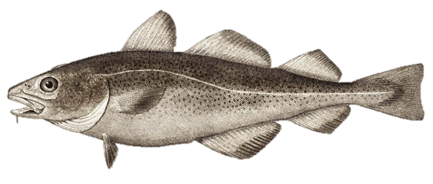
Atlantic cod genome

Slide 6

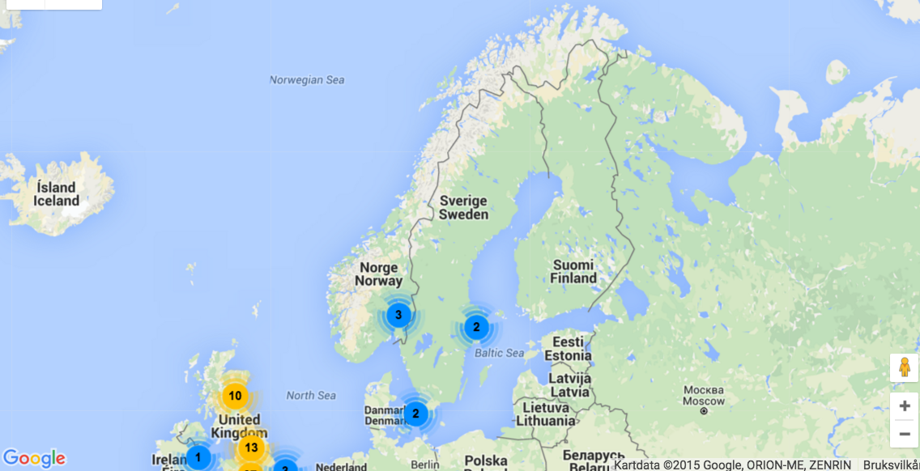
Instructor since 2013

Slide 7
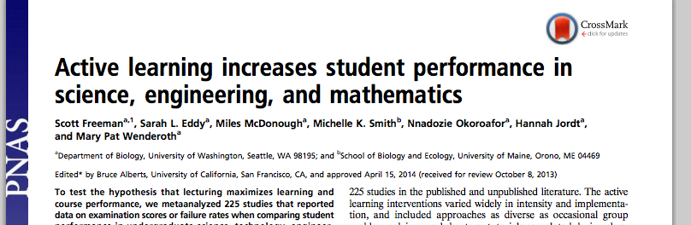
(Inter)active learning
doi: 10.1073/pnas.1319030111

Slide 8
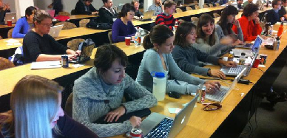
(Inter)active learning
Software Carpentry = active learning
https://software-carpentry.org/pages/testimonials.html

Slide 9
This session
Examples of other approaches to active learning
Online
Offline

Slide 10
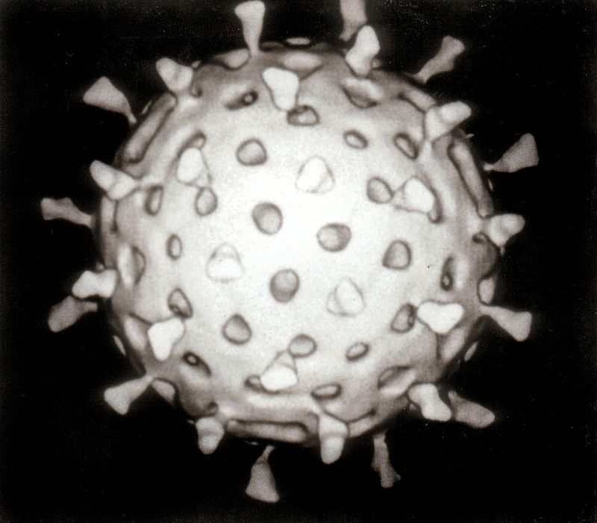


Genomes
Rotavirus
18,555 characters
Escherichia coli bacterium
4 to 5 million characters
Homo sapiens
3.2 billion characters
‘Characters’: A, C, G and T
Graham Beards -CC BY 3.0 via Commons - https://commons.wikimedia.org/wiki/File:Rotavirus_Reconstruction.jpg#/media/File:Rotavirus_Reconstruction.jpg & Rocky Mountain Laboratories, NIAID, NIH Public Domain via Commons - https://commons.wikimedia.org/wiki/File:EscherichiaColi_NIAID.jpg#/media/File:EscherichiaColi_NIAID.jpg

Slide 11
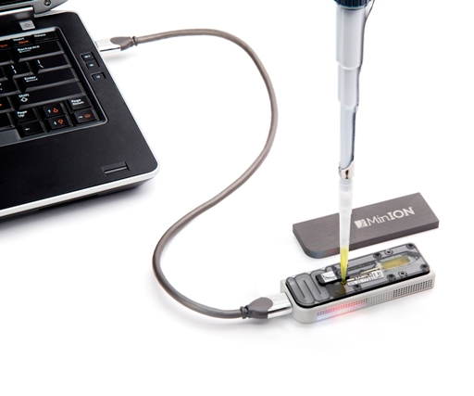
Sequencing
HiSeq from Illumina
RS II from
Pacific Biosciences
MinION from
Oxford Nanopore
125 characters
Billions of them
Up to 75,000 characters
Around a million of them
Up to 100,000 characters
Half a million of them

Slide 12
What is this ‘assembly’ thing?
ACGCGATTCAGGTTACCA
CAGGTTACCACGCGTACG
GCGATTCAGGTTACCACG
ACCACGCGTACGCGATTA
GATTCAGGTTACCACGCG
TTCAGGTTACCACGCGTA
GGTTACCACGCGTACGCG
CACGCGTACGCGATTACA
TTACCACGCGTACGCGAT
CGCGTACGCGATTACACA
TACGCGATTACACAGATTAG
CGTACGCGATTACACAGATT

Slide 13
What is this ‘assembly’ thing?
ACGCGATTCAGGTTACCA
GCGATTCAGGTTACCACG
GATTCAGGTTACCACGCG
TTCAGGTTACCACGCGTA
CAGGTTACCACGCGTACG
GGTTACCACGCGTACGCG
TTACCACGCGTACGCGAT
ACCACGCGTACGCGATTA
CACGCGTACGCGATTACA
CGCGTACGCGATTACACA
CGTACGCGATTACACAGATT
TACGCGATTACACAGATTAG
ACGCGATTCAGGTTACCACGCGTACGCGATTACACAGATTAG

Slide 14
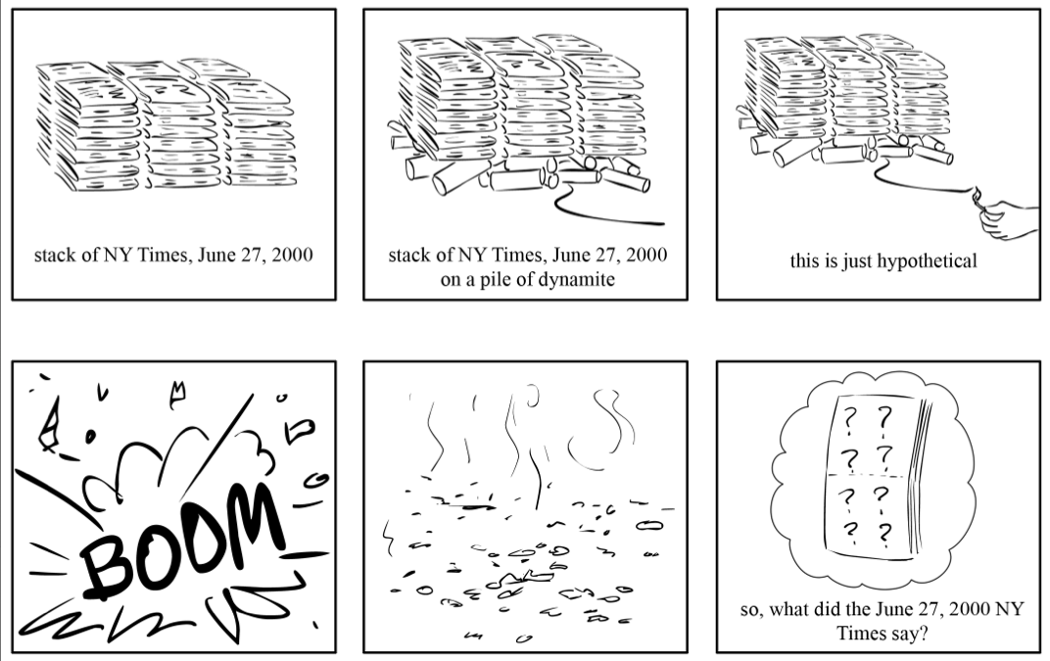
An analogy
Compeau & Pevzner 2010 http://cseweb.ucsd.edu

Slide 15
An analogy
"It was the best of times, it was the worst of times, it was the age of wisdom, it was the age of foolishness, it was the epoch of belief, it was the epoch of incredulity,…
Charles Dickens, “A Tale of Two Cities”
Now we shred a bunch of copies
Slides courtesy of/after Mike Schatz, Cold Spring Harbor Laboratory http://schatzlab.cshl.edu/teaching/2014/
Quote: https://en.wikisource.org/wiki/A_Tale_of_Two_Cities/Book_the_First/Chapter_I

Slide 16
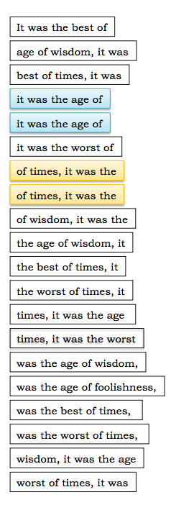
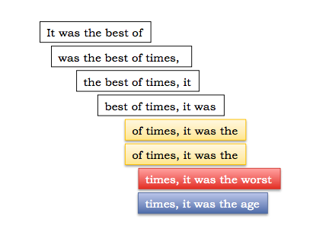
An analogy
"It was the best of times, it was the worst of times, it was the age of wisdom, it was the age of foolishness, it was the epoch of belief, it was the epoch of incredulity,…
Slides courtesy of/after Mike Schatz, Cold Spring Harbor Laboratory http://schatzlab.cshl.edu/teaching/2014/

Slide 17
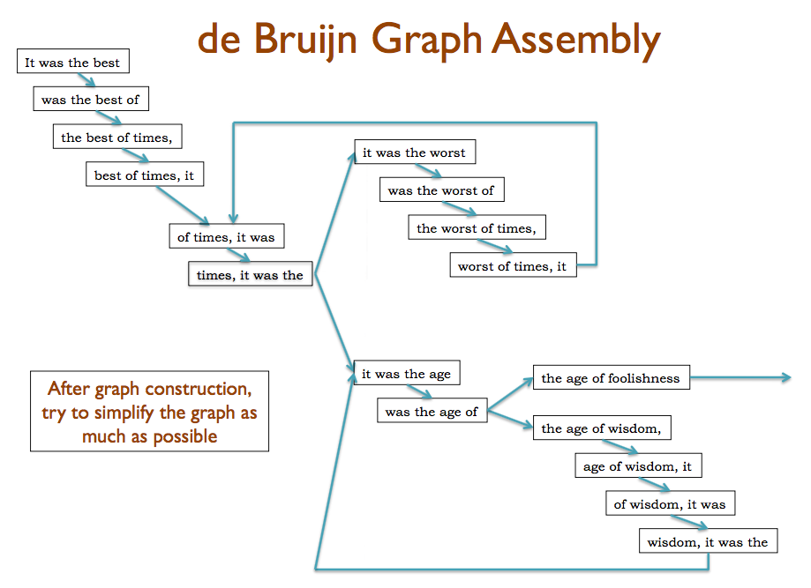
Slides courtesy of/after Mike Schatz, Cold Spring Harbor Laboratory http://schatzlab.cshl.edu/teaching/2014/

Slide 18
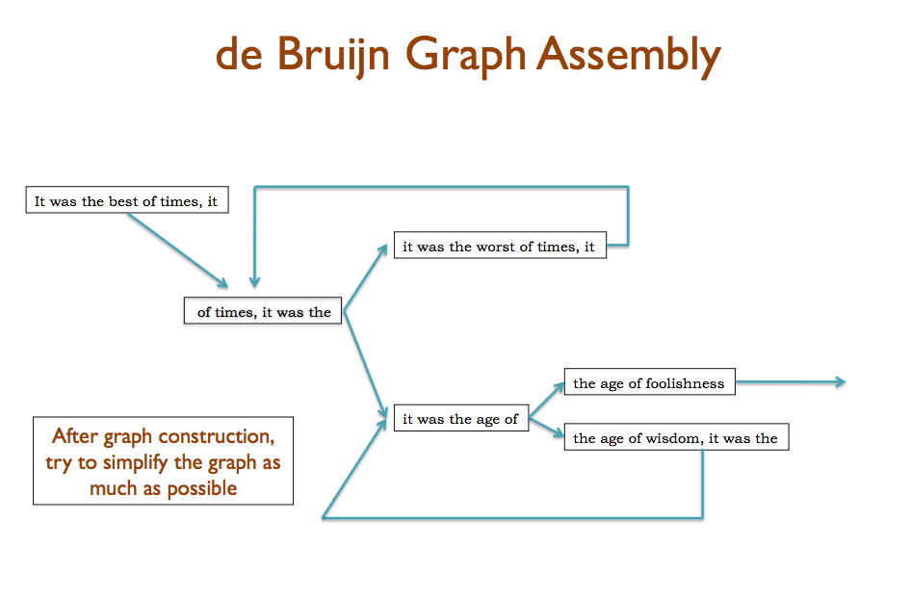
Slides courtesy of/after Mike Schatz, Cold Spring Harbor Laboratory http://schatzlab.cshl.edu/teaching/2014/

Slide 19
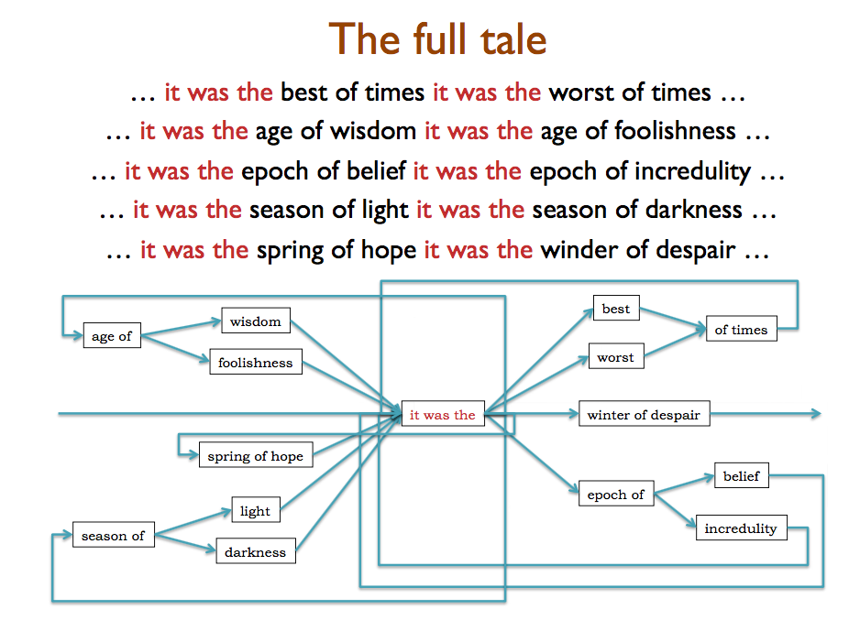
Slides courtesy of/after Mike Schatz, Cold Spring Harbor Laboratory http://schatzlab.cshl.edu/teaching/2014/

Slide 20

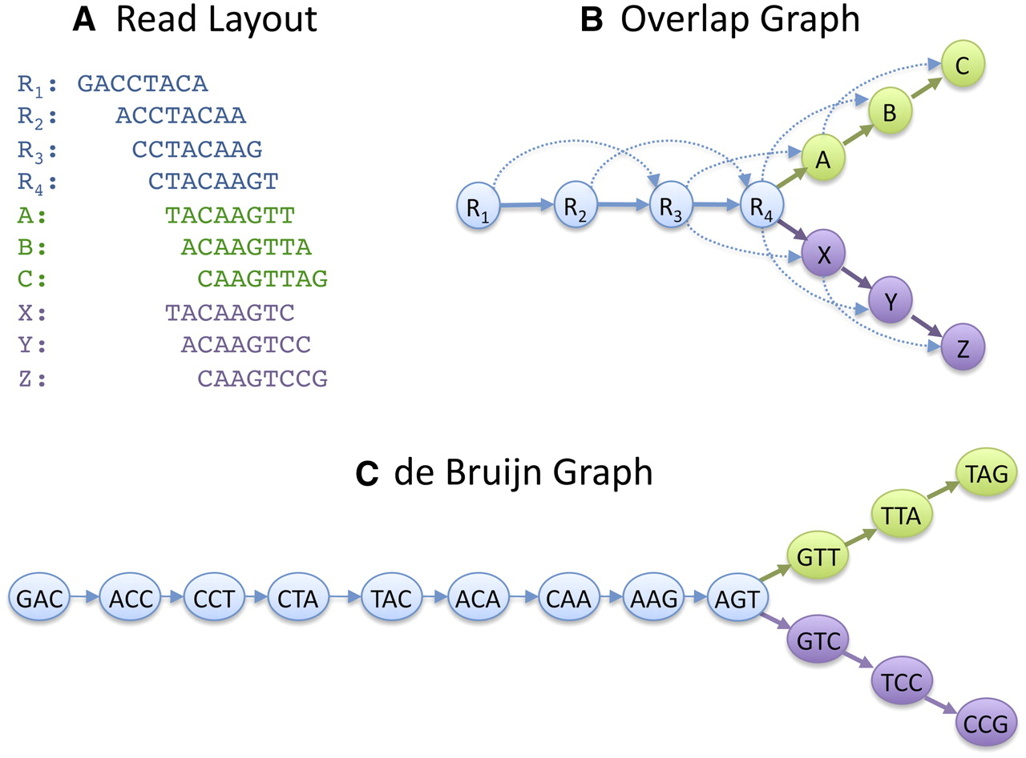
de Bruijn graphs
Developed outside of DNA-related work
Best solution for very short reads ≤100 nt
Read
GACCTACA
GAC
ACC
CCT
CTA
TAC
ACA
de Bruijn graph
K-mers (K=3)
K-1 bases overlap

Slide 21
Graphs
GACCTACA
ACCTACAA
CCTACAAG
CTACAAGT
TACAAGTT
ACAAGTTA
CAAGTTAG
TACAAGTC
ACAAGTCC
CAAGTCCG
Schatz M C et al. Genome Res. 2010;20:1165-1173

Slide 22
kmers
Need to be odd
Cannot be longer than the reads

Slide 23
Next steps
Install the velvet assembly program
Download some reads
Pick a kmer
Run velvet assembly using that kmer
Compare results

Slide 24
Metrics
ACGCGATTCAGGTTACCA
GCGATTCAGGTTACCACG
GATTCAGGTTACCACGCG
TTCAGGTTACCACGCGTA
CAGGTTACCACGCGTACG
GGTTACCACGCGTACGCG
TTACCACGCGTACGCGAT
ACCACGCGTACGCGATTA
CACGCGTACGCGATTACA
CGCGTACGCGATTACACA
CGTACGCGATTACACAGATT
TACGCGATTACACAGATTAG
ACGCGATTCAGGTTACCACGCGTACGCGATTACACAGATTAG
→ “contig”

Slide 25
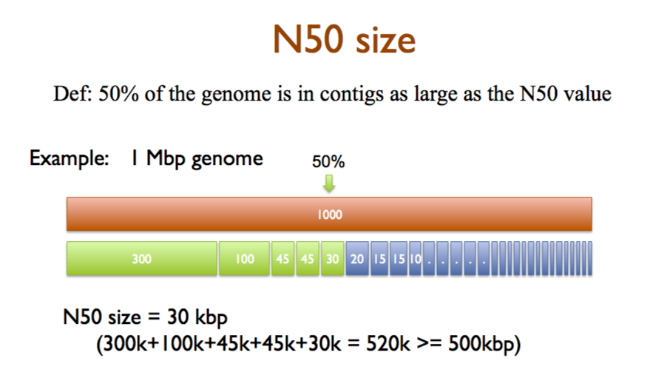
Metrics
Slides courtesy of/after Mike Schatz, Cold Spring Harbor Laboratory http://schatzlab.cshl.edu/teaching/2014/

Slide 26
Next steps
Install the velvet assembly program
Download some reads
(150 bp MiSeq paired reads)
Pick a kmer
Run velvet assembly using that kmer
Compare results

Slide 27
Important!
Compile velvet allowing for kmers up to 127:
make 'MAXKMERLENGTH=127'

Slide 28
Sticky notes

Slide 29
Conclusion

